Slide 1
Objective: to become familiar with uml and USE CASE DIAGRAMS
LAB#01

Slide 2
Why model systems?
Fundamental reason: We build models so that we can better understand the system we are developing.
Modeling can achieve the following aims:
Models help us to visualize a system as it is or as we want it to be.
Models permit us to specify the structure or behavior of a system.
Models give us a template that guides us in constructing a system.
Models document the decisions we have made.

Slide 3
UML: UNIFIED MODELING LANGUAGE
The objective of UML is to provide system architects, software engineers, and software developers with tools for analysis, design, and implementation of software-based systems as well as for modeling business and similar processes.
UML provides a specification of the human-readable notation elements for representing the individual UML modeling concepts as well as rules for combining them into a variety of different diagram types corresponding to different aspects of modeled systems.

Slide 4
UML - Modeling Types
It is very important to distinguish between the UML model.
Different diagrams are used for different type of UML modeling.
There are three important type of UML modelings

Slide 5
Structural modeling
Structural modeling captures the static features of a system. They consist of the followings:
Class diagrams, Object diagrams, Deployment diagrams, Package diagrams, Composite structure diagram, Component diagram.
They all represent the elements and the mechanism to assemble them.
But the structural model never describes the dynamic behavior of the system. Class diagram is the most widely used structural diagram.

Slide 6
Behavioral Modeling
Behavioral model describes the interaction in the system. It represents the interaction among the structural diagrams.
Behavioral modeling shows the dynamic nature of the system. They include the following:
Activity diagrams
Interaction diagrams
Use case diagrams
State chart diagrams
All the above show the dynamic sequence of flow in a system.

Slide 7
Architectural Modeling
Architectural model represents the overall framework of the system.
It contains both structural and behavioral elements of the system. Architectural model can be defined as the blue print of the entire system.
Package diagram comes under architectural modeling.

Slide 8
To model a system the most important aspect is to capture the dynamic behavior.

Slide 9
Use case diagram
A use case diagram is a graphic depiction of the interactions among the elements of a system.
A usecase is a methodology used in system analysis to identify, clarify, and organize system requirements.
Use case diagrams are consists of actors, use cases and their relationships.
The diagram is used to model the system/subsystem of an application. A single use case diagram captures a particular function of a system.
So to model the entire system numbers of use case diagrams are used.

Slide 10
For example, use cases in a product sales environment would include item ordering, catalog updating, payment processing, and customer relations.

Slide 11
Drawing use case diagrams
Usecase (Functionalities)
Actors
Relationships

Slide 12
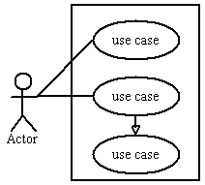
Symbols and Notations
System:
Draw your system's boundaries using a rectangle that contains use cases. Place actors outside the system's boundaries.

Slide 13
2. Usecase:
Use cases are the system functionalities written in an organized manner.
Draw use cases using ovals. Label the ovals with verbs that represent the system's functions.
Order item

Slide 14
3. Actors:
Actors can be defined as something that interacts with the system.
The actors can be human user, some internal applications or may be some external applications.
An actor specifies a role played by a user or any other system that interacts with the subject.

Slide 15
4. Relationships:
Illustrate relationships between an actor and a use case with a simple line.
Relationships between the usecases:
Extend
Include
Generalization

Slide 16
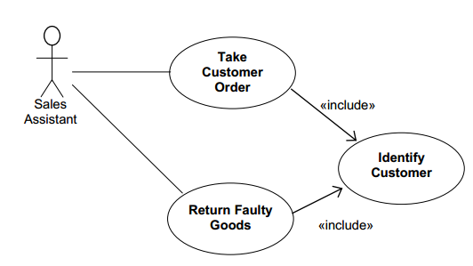
Include Relationship
In UML modeling, an include relationship is a relationship in which one use case (the base use case) includes the functionality of another use case (the inclusion use case). It supports the reuse of functionality in a use-case model.

Slide 17
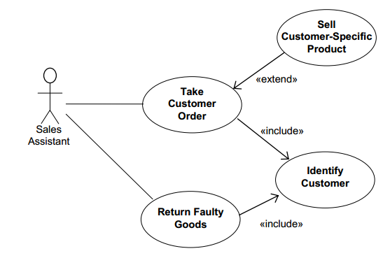
Extend Relationship
You can use an extend relationship to specify that one use case (extension) extends the behavior of another use case (base). This type of relationship reveals details about a system or application that are typically hidden in a use case.

Slide 18
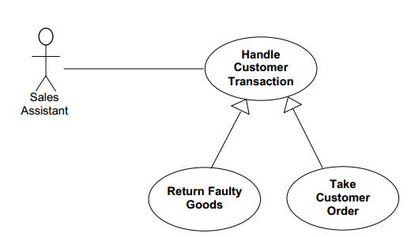
Generalization
Generalization relationships are used in class, component, deployment, and use-case diagrams to indicate that the child receives all of the attributes, operations, and relationships that are defined in the parent.

Slide 19
Guidelines
Use appropriate names for usecases to reflect functionality and suitable names for actors as well.
Show relationships clearly
Use notes where necessary

Slide 20
Usage of Usecase diagrams
Requirement analysis and high level design.
Model the context of a system.
Reverse engineering.
Forward engineering.

Slide 21
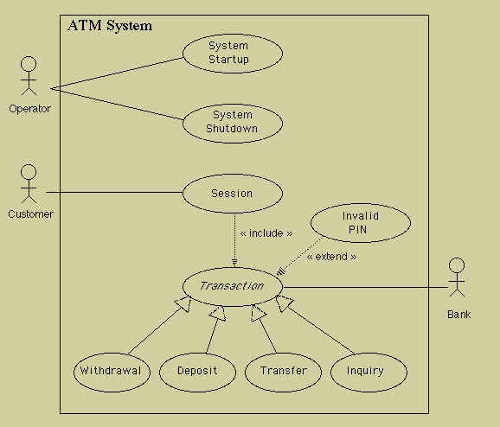
Sample use case diagram

Slide 22
LAB TASK
Create a usecase diagram for online Human Resource Management system. Show atleast two actors and various usecases along with the relationships (extended, inculde, generaization) between them.
DEADLINE FOR SUBMISSION:

